Slide 1





Usability Testing
Usability VS UX
Usability Metrics
Test Design, Participant Recruitment and Running the Test
Data Analysis and Reflective Design Process (Success Rate)

Slide 2
What is it with the Fork?

Slide 3
Usability
Cutlery
Function
Design

Slide 5

Emotional aspect of the Fork

Slide 6

No..! It is how cool the Fork is. …….

Slide 7

What about modernity and colours….

Slide 8

Or maybe creativity …………

Slide 9

I only care about functionality…..

Slide 10
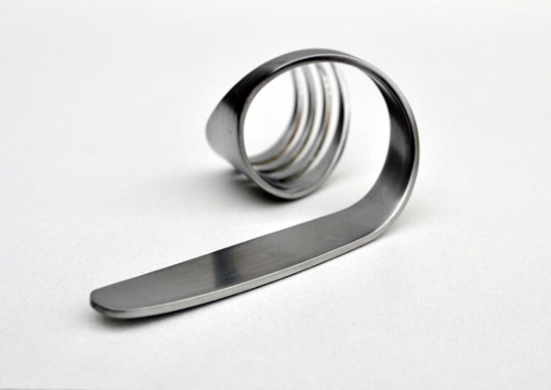
No….. it is about complexity …
Is this even a fork …☹

Slide 11


Things are about to get worse?!!!
Go ahead, be in a hurry. Never wait for your food to cool down ever again.

Slide 12

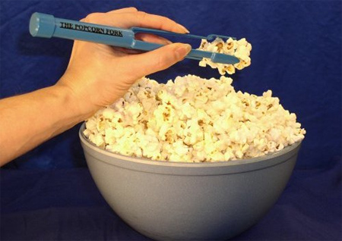


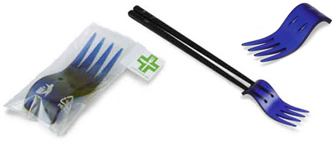
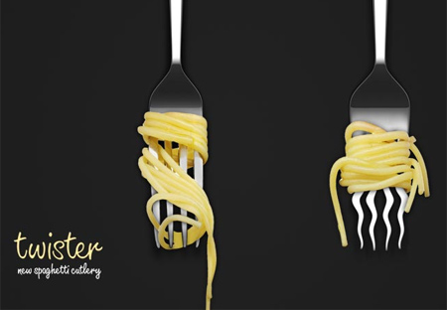
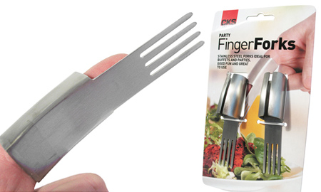
Which fork defines the best usability

Slide 13
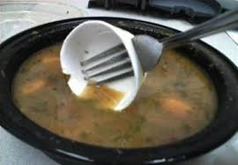
Usability
Usability of a product is the extent, to which it can be used by a certain user, to achieve effectively, efficiently and satisfyingly certain goals in a certain context.
ISO 9241 definition

Slide 14
Usability
The effectiveness, efficiency and satisfaction with which specified users achieve specified goals in particular environments.
Effectiveness: the accuracy and completeness with which specified users can achieve specified goals in particular environments
Efficiency: the resources expended in relation to the accuracy and completeness of goals achieved
Satisfaction: the comfort and acceptability of the work system to its users and other people affected by its use

Slide 15

Utility & Usability
Utility = whether it provides the features you need.
Usability = how easy & pleasant these features are to use.
Useful = usability + utility.

Slide 16
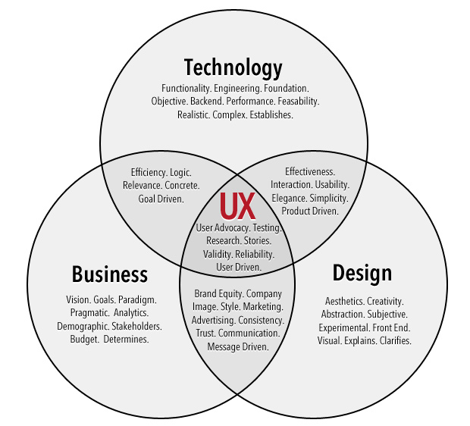
UX
involves a person's behaviours, attitudes, and emotions about using a particular product, system or service. User experience includes the practical, experiential, affective, meaningful and valuable aspects of human–computer interaction and product ownership.

Slide 17
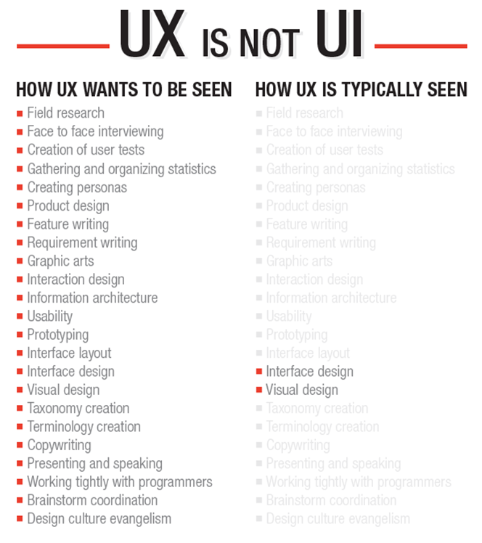

Slide 18
Usability Why?
Track progress between releases. You cannot fine-tune your methodology unless you know how well you're doing.
Assess your competitive position. Are you better or worse than other companies? Where are you better or worse?
Make a Stop/Go decision before launch. Is the design good enough to release to an unsuspecting world?
Create bonus plans for design managers and higher-level executives. For example, you can determine bonus amounts for development project leaders based on how many customer-support calls or emails their products generated during the year.
Usability is the measure of the quality of a user's experience when interacting with a product or system - whether a web site, software application, mobile technology, or any user-operated device.

Slide 21
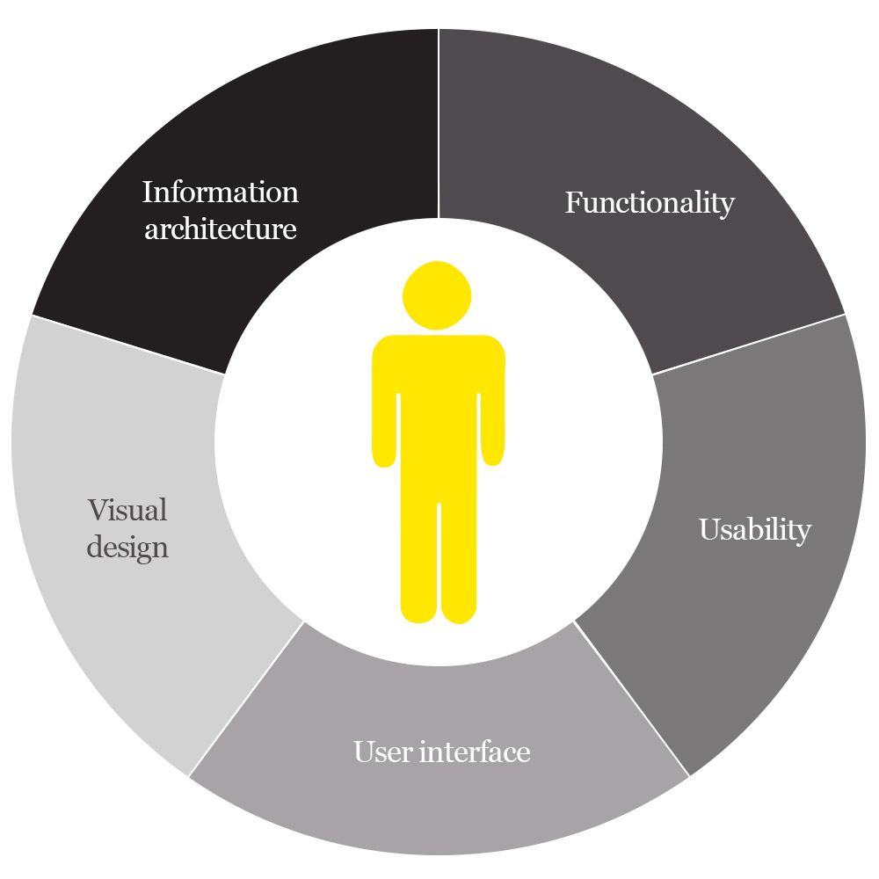

Slide 22

Final Year Project:
How usability could fit within your theoretical framework

Slide 23

Why and how to test

Slide 24

Why?
Some projects are inherently HCI based, and as pat of your Software Development Life Cycle, you have to test your digital artefacts.
Other projects would benefit from UX and Usability testing.

Slide 25
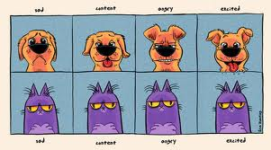
How ?
Inductive VS Deductive

Slide 26
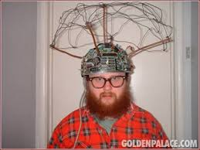
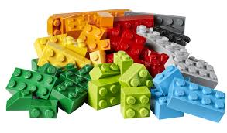

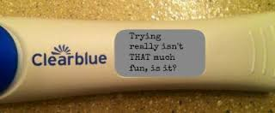
Inductive
Something in mind
(We don’t care subjective or objective/ Yours or others, we only care about that it is in your mind and you think is problematic )
Formulate
(Hypotheses – Assumptions)
Cause and effect
philosophical concept of causality
Observe / Test
Confirmation

Slide 27
Inductive
Something in mind
(We don’t care subjective or objective/ Yours or others, we only care about that it is in your mind and you think it is problematic )
Formulate
(Hypotheses – Assumptions)
Cause and effect
philosophical concept of causality
Observe / Test
Confirmation

Slide 28

Deductive
Observe
Pattern
Formulate
(Hypotheses – Assumption)
Cause and effect
philosophical concept of causality
Confirmation
Something in mind

Slide 29
How Inductive/Deductive thing fits into Usability testing and my final year project?
Inductive Deductive
Project Objectives
Project Evaluation
Test Metrics
Test
Confirm
Test
Test Metrics
Project Evaluation
Project Objectives
Confirm

Slide 30

Test Design
1- Define you test design metrics?
What do you want to test?
2- Define your Success Rate in the context of Usability?
3- Construct Test Tasks?
4- Define your subject base? Demographic characteristics of your Users

Slide 31
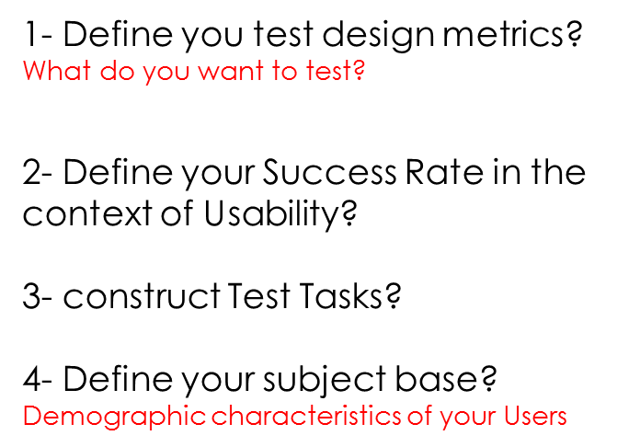
Test Design Metrics
Layout: Inability to detect something users need to find; Aesthetic problems; Unnecessary Information.
Terminology: Unable to understand the terminology.
Feedback: User does not receive relevant feedback or it is inconsistent with what the user expects.
Comprehension: Inability to understand the instructions given to users on the site.
Data Entry: Problems with entering information.
Navigation: Problems with finding users way around the test site/system/software.

Slide 32
How to Measure It is easy to specify usability metrics, but hard to collect them. Typically, usability is measured relative to users' performance on a given set of test tasks. The most basic measures are based on the definition of usability as a quality metric:
Success rate (whether users can perform the task at all)
The time a task requires.
The error rate.
Users' subjective satisfaction.

Slide 33
Success Rate
Layout: Inability to detect something users need to find; Aesthetic problems; Unnecessary Information.
Terminology: Unable to understand the terminology.
Feedback: User does not receive relevant feedback or it is inconsistent with what the user expects.
Comprehension: Inability to understand the instructions given to users on the site.
Data Entry: Problems with entering information.
Navigation: Problems with finding users way around the test site/system/software.
Success rate (whether users can perform the task at all)
The time a task requires.
The error rate.
Users' subjective satisfaction.

Slide 34
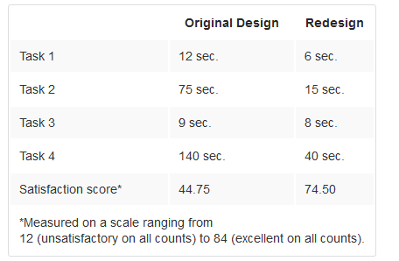
Measuring Success
Comparing Two Designs
To illustrate quantitative results, we can look at those recently posted by Macromedia from its usability study of a Flash site, aimed at showing that Flash is not necessarily bad. Basically, Macromedia took a design, redesigned it according to a set of usability guidelines, and tested both versions with a group of users. Here are the results:

Slide 35
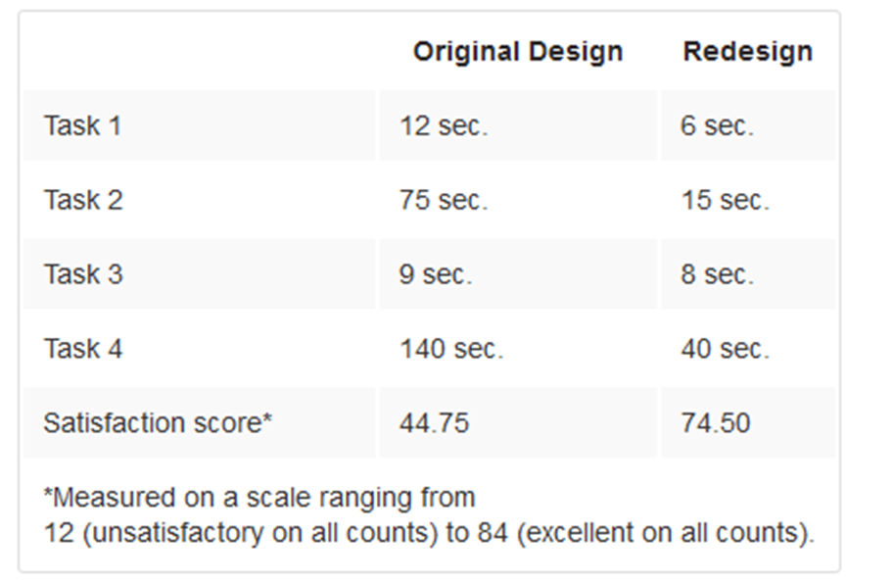
Measuring Success
Task 1: relative score 200% (improvement of 100%).
Task 2: relative score 500% (improvement of 400%).
Task 3: relative score 113% (improvement of 13%).
Task 4: relative score 350% (improvement of 250%).

Slide 36
Test Task
Layout
Terminology
Feedback
Comprehension
Data Entry
Navigation
Success rate (whether users can perform the task at all)
The time a task requires.
The error rate.
Users' subjective satisfaction.
1- Test one usability metric
2- Four tasks maximum
3- Predefined benchmark :
Number of steps
Time Required

Slide 37


Slide 38


Slide 40
Layout
Layout
Terminology
Navigation
Navigation

Slide 41
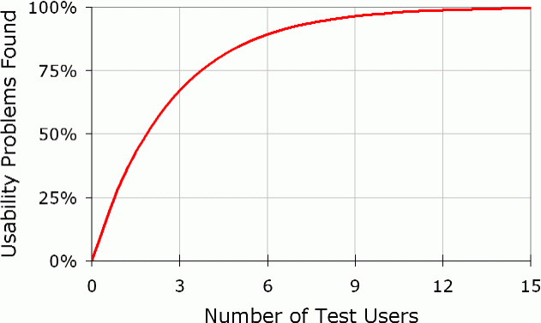
Test Task
Layout
Terminology
Feedback
Comprehension
Data Entry
Navigation
Success rate (whether users can perform the task at all)
The time a task requires.
The error rate.
Users' subjective satisfaction.
1- Four tasks maximum
2- Test one usability metric only
3- Have a Predefined benchmark
- Number of steps
- Time Required
5 Participants at most
Subjects should be typical user of the system, or possess interests with the domain.
Make a list (Names, Time and Contact details)

Slide 42
Consent Forms

Slide 44
Running the test
Pilot Testing
Prior to conducting a usability test, make sure you have all of your materials, consents and documentation prepared and checked. It is important to pilot test equipment and materials with a volunteer participant. Run the pilot test 10 – 15 minutes prior to the first test session so that you have time to deal with any technical issues, or change the scenarios or other materials if necessary.
The pilot test allows you to:
Test the equipment
Provides practice for the facilitator and note-takers
Get a good sense whether your questions and scenarios are clear to the participant
Make any last minute adjustments

Slide 45
Testing Techniques
Concurrent Think Aloud (CTA) is used to understand participants’ thoughts as they interact with a product by having them think aloud while they work. The goal is to encourage participants to keep a running stream of consciousness as they work.
Retrospective Think Aloud (RTA), the moderator asks participants to retrace their steps when the session is complete. Often participants watch a video replay of their actions, which may or may not contain eye-gaze patterns.
Concurrent Probing (CP) requires that as participants work on tasks—when they say something interesting or do something unique, the researcher asks follow-up questions.
Retrospective Probing (RP) requires waiting until the session is complete and then asking questions about the participant’s thoughts and actions. Researchers often use RP in conjunction with other methods—as the participant makes comments or actions, the researcher takes notes and follows up with additional questions at the end of the session.

Slide 46
Testing Techniques
Concurrent Think Aloud (CTA) is used to understand participants’ thoughts as they interact with a product by having them think aloud while they work. The goal is to encourage participants to keep a running stream of consciousness as they work.
Retrospective Probing (RP) requires waiting until the session is complete and then asking questions about the participant’s thoughts and actions. Researchers often use RP in conjunction with other methods—as the participant makes comments or actions, the researcher takes notes and follows up with additional questions at the end of the session.

Slide 47

Running the test

Slide 48
Running the test
1- Run Tobi studio 3.21
https://www.youtube.com/watch?v=tpLUkKN3AWE

Slide 49

Tobi Studio 3.2

Slide 51
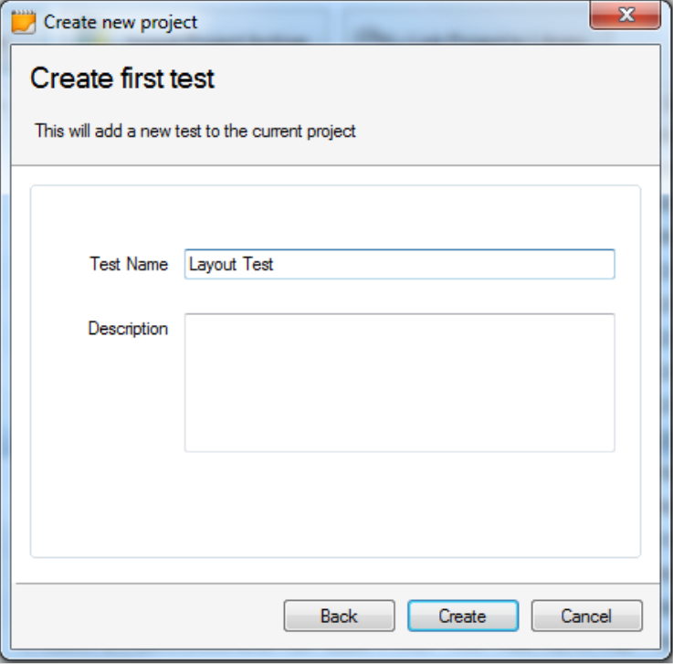
Project → Test

Slide 53
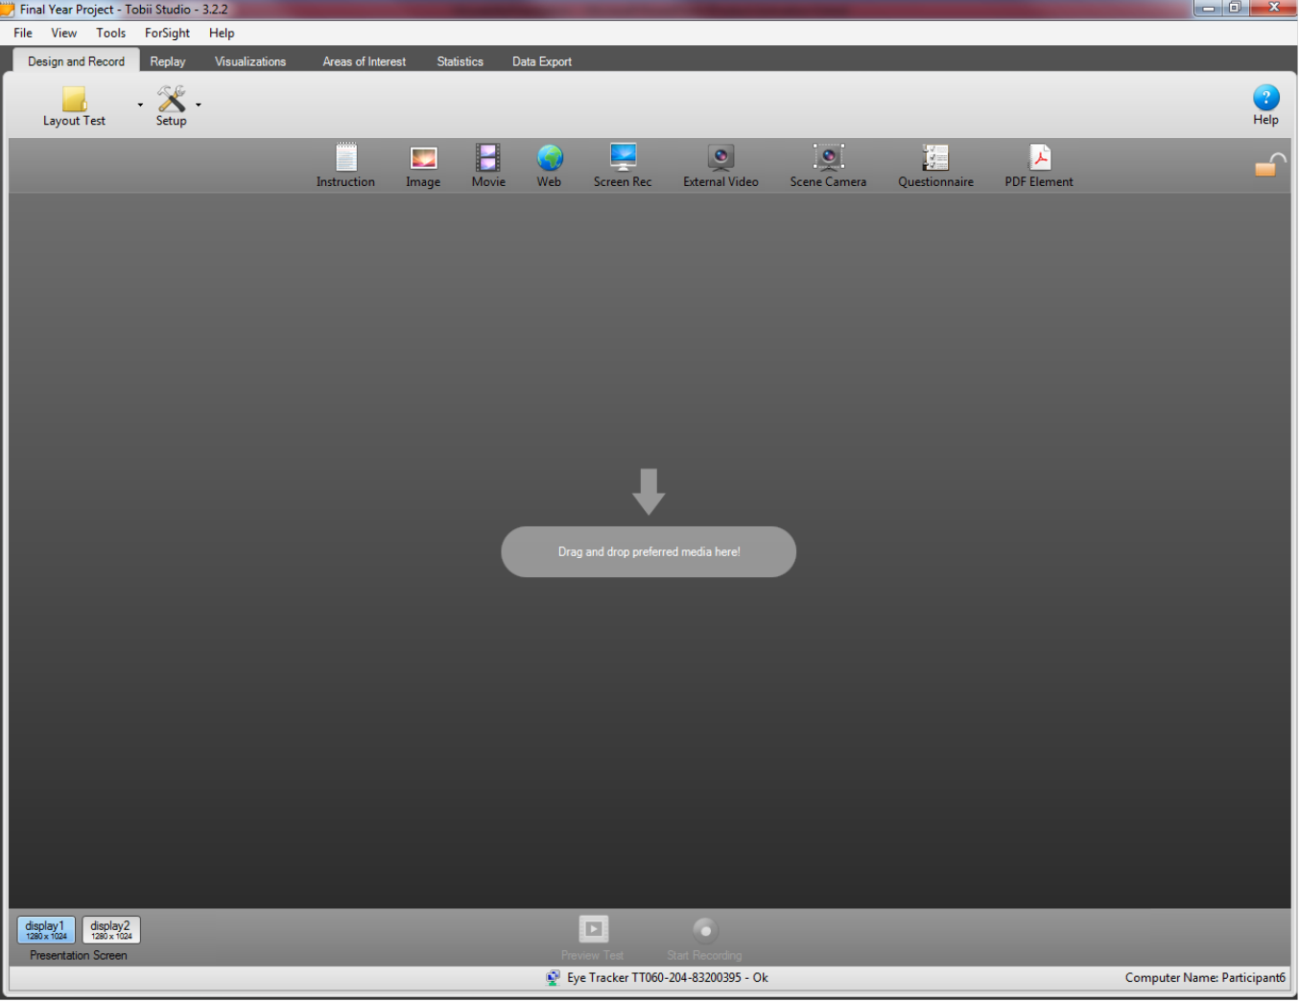

Slide 56
Project → Test → Participant

Slide 58
Celebrating

Slide 59
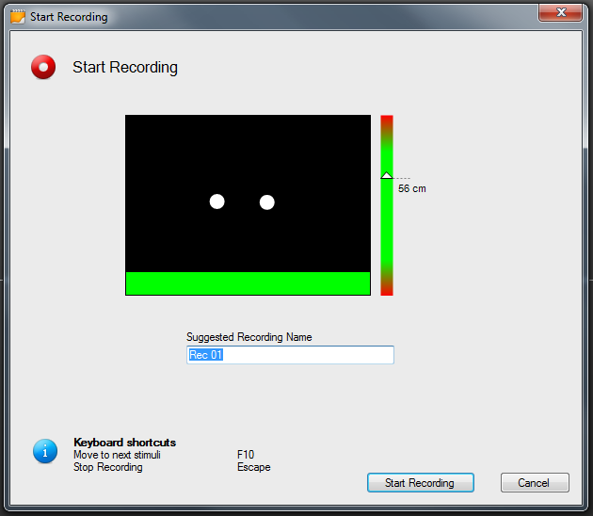

Slide 60
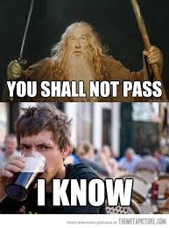
Remember
Tobi uses Internet Explorer with specific adds-on to collect browser data

Slide 64
Best Practices
Treat participants with respect and make them feel comfortable.
Remember that you are testing the site not the users. Help them understand that they are helping us test the prototype or Web site.
Remain neutral – you are there to listen and watch. If the participant asks a question, reply with “What do you think?” or “I am interested in what you would do.”
Do not jump in and help participants immediately and do not lead the participant. If the participant gives up and asks for help, you must decide whether to end the scenario, give a hint, or give more substantial help.
The team should decide how much of a hint you will give and how long you will allow the participants to work on a scenario when they are clearly going down an unproductive path.
Take good notes. Note-takers should capture what the participant did in as much detail as possible as well as what they say (in their words). The better the notes are that are taken during the session, the easier the analysis will be.
Measure both performance and subjective (preference) metrics. People's performance and preference do not always match. Often users will perform poorly but their subjective ratings are very high. Conversely, they may perform well but subjective ratings are very low.
Performance measures include: success, time, errors, etc.
Subjective measures UX include: user's self reported satisfaction and comfort ratings

Slide 65
Thank you
Q & A

